Slide 1
Understanding Self

Slide 2
Self in the Context of School

Slide 3
Developing Self is a continuous process that is probably life-long. This process includes many aspects where we want to bring about a change related to our behaviour, our thinking or in terms of knowledge or skills. You may want to improve your behaviour while relating with others, create a more positive attitude, expose yourself to different life experiences, develop professionally through self-reading, learning from other colleagues or attending in-service programmes

Slide 4
What are the basic attributes that I need to have to become an effective leader?

Slide 5
video

Slide 6
Answer the questions 1.What were you first emotions watching this video clip? 2.What do you think is the message of this video? Who was the real ‘leader’ in the video – the child or the politician? 3.What one lesson you derive from this video that can be linked to how a leader must act?

Slide 7
List down some of the basic characteristics of a person who takes the role of a leader.

Slide 8
1. One who ‘initiates’ or takes the first step 2. Maintains a positive outlook 3. 4. 5.

Slide 9
Identifying Action Step for School Change

Slide 10
Tomorrow, as you enter your school, what is that one thing you would promise to yourself that must change in the school? How would you lead that change? Reflect and write:

Slide 11
Why am 'I' important in the context of the school? Why do 'I' need to improve myself to emerge as a school leader?

Slide 12
video

Slide 13
The Johari Window: A Model for Self-Understanding
Model considers that there is information
you and others know
only you know about yourself
only others know about you
nobody knows

Slide 14
The Johari Window
Your willingness or unwillingness to engage is self-disclosure, and listen to feedback, has a lot to do with your understanding of yourself and others’ understanding of you.

Slide 15
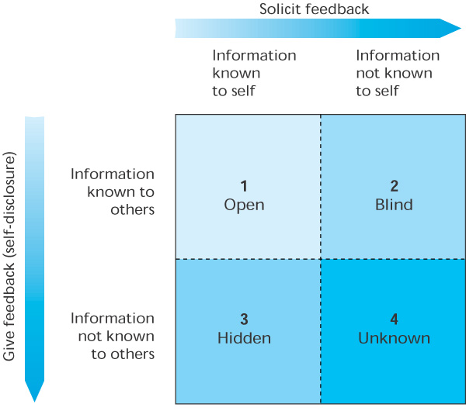

Slide 16
The Four Panes of the Johari window
Open
Blind
Hidden
Unknown

Slide 17
Open Area
Represents the “public” or “awareness” area and contains information that both you and others know
Information that you don’t mind admitting
Gets bigger over time as relationships mature

Slide 18
Blind Area
Information about yourself that others know but you are not yet aware
Others may see you differently than you see yourself
Effective relations strive to reduce this area
Open communication encourages people to give you feedback

Slide 19
Unknown Area
Information that is unknown to you and to others
Areas of unrecognized talent, motives, or early childhood memories that influence your behavior
Always present, never disappears
Open communication can expose some of this area

Slide 20
The Johari Window
Fill up the johari window

Slide 21
Self-Disclosure: An Introduction
The process of letting another person know what you think, feel, or want
Revealing private, personal information that can not be acquired somewhere else
Usually involves some degree of risk
Examples include your feelings about
being a member of a minority group
job security
policies and procedures

Slide 22
Increased Self-awareness
Self-awareness
The ability to recognize and understand your moods, emotions, drives and their effect on others
The foundation on which self-development is built
Increases as you receive feedback from others
Enhances awareness of common interests and concerns

Slide 23
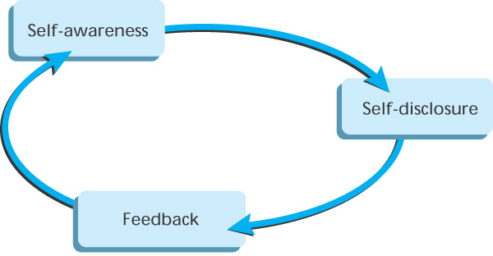
Self Disclosure/ Feedback/ Self-Awareness Cycle

Slide 24
Appropriate Self-Disclosure
Information should be disclosed in constructive ways
Anyone can learn this skill
Often means changing attitudes and behaviors
Questions about disclosing information:
How much and how intimate?
With whom?
Under what conditions?

Slide 25
360-Degree Feedback
360-degree feedback is based on belief that employees will benefit from feedback collected from several sources
Evaluations by boss, peers, subordinates, and sometimes customers
Often in questionnaire form
Involves risk if not done correctly

Slide 26
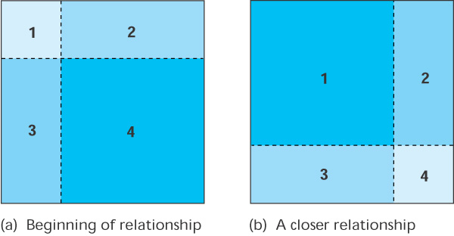
Johari Window at the Beginning of a Relationship (left) and After a Closer Relationship Has Developed (right)

Slide 27
Constructive Criticism
Constructive criticism is a form of self-disclosure that helps another person look at their own behavior without putting that person on the defensive
Not the same as blaming
Skill that can be mastered through learning and practice
Replace “You” statements with “I” statements
Request changes “in the future” instead of pointing out something negative in the present

Slide 28
The Right Time and Place
What you say may be fine, the when and where may be the problem
Select a time when the other person will not be preoccupied and will give full attention
Select a place free from distractions such as telephone calls or visitors
Make an appointment, if necessary

Slide 29
Avoid Overwhelming Others
Be open, but do not go too far too fast
Relationships are built slowly
Abrupt disclosure of emotional or intimate information may distance you from others
Balance between openness and protection of each other’s feelings

Slide 30
Avoid Overwhelming Others
Buddha recommends asking yourself three questions before speaking:
Is the statement true?
Is the statement necessary?
Is the statement kind?
If the statement falls short on any one, Buddha advised that we say nothing

Slide 31
Johari Window also relate to Emotional Intelligence (EQ)
Self Awareness | Social Awareness
Self-management | Relationship Management

Slide 32
Emotional Intelligence (EQ)
By developing EQ, we can be more productive and successful at what we do, and help others to be more productive and successful
EQ can reduce stress for individuals and
organizations, by decreasing conflict,
improving relationships and understanding, and increasing stability, continuity and harmony

Slide 33
!
ATTITUDE
IS
EVERY THING

Slide 34


THE ICEBERG
HOW MUCH DO YOU SEE OF AN ICEBERG?

Slide 35

THE ICEBERG
ONLY 10 OF ANY ICEBERG IS VISIBLE. THE REMAINING 90% IS BELOW SEA LEVEL.

Slide 36
THE ICEBERG
10 %
VISIBLE
ABOVE SEA LEVEL
SEA LEVEL
INVISIBLE
BELOW SEA LEVEL
90 %

Slide 37
THE ICEBERG
The Iceberg phenomena is also applicable on human beings …

Slide 38
THE ICEBERG
KNOWLEDGE
&
SKILLS
KNOWN
TO OTHERS
SEA LEVEL
UNKNOWN
TO OTHERS
ATTITUDE

Slide 39
THE ICEBERG
In other words,

Slide 40
THE ICEBERG
BEHAVIOR
KNOWN
TO OTHERS
SEA LEVEL
UNKNOWN
TO OTHERS
IMPACT
VALUES – STANDARDS – JUDGMENTS
ATTITUDE
MOTIVES – ETHICS - BELIEFS

Slide 41
THE CAN DO ATTITUDE
You CAN DO everything, but not all at once.
You CAN DO everything, if it’s important enough for you to do.
You CAN DO everything, but you may not be the best at everything.
You CAN DO everything, but there will be limitations.
You CAN DO everything, but you’ll need help.

Slide 42
BEST QUOTES ON POSITIVE ATTITUDE
A positive thought is the seed of a positive result.
If you don’t like something, change it. If you can’t change it, change your attitude. Don’t complain.
The most significant change in a person’s life is a change of attitude. Right attitudes produce right actions.
If you really want to be happy, nobody can stop you except God.

Slide 43
BEST QUOTES ON POSITIVE ATTITUDE
Whether a glass if half-full or half-empty, depends on the attitude of the person looking at it.
There is a better way for everything. Find it.
A positive attitude is not a destination. It is a way of life.
The difference between a successful person and others is not a lack of knowledge, but rather a lack of will.

Slide 44
BEST QUOTES ON POSITIVE ATTITUDE
The positive thinker sees the invisible, feels the intangible, and achieves the impossible.
The man with confidence in himself gains the confidence of others.
You will only go as far as you think you can go.
The biggest mistake of all is to avoid situations in which you might make a mistake.

Slide 45
BEST QUOTES ON POSITIVE ATTITUDE
A positive attitude is like a magnet for positive results.
Our life is a reflection of our attitudes.
Positive attitudes create a chain reaction of positive thoughts.
Attitude, not aptitude, determines your altitude.
No man fails if he does his best.

Slide 46
BEST QUOTES ON POSITIVE ATTITUDE
Sooner or later, those who win are those who think they can.
A creative attitude is the fuel of progress and growth.
Either I will find a way, or I will make one.
Be the change you want to see in this world.
Forgive others and you will be forgiven.

Slide 47
+
How to Stay
POSI
IVE
in a
TOUGH
Work Environment

Slide 48
The Environment
Other People’s
Behavior
Changing Environment
YOU
Negative Work Environment
Ouch!
Past Experiences
Negative World View
Determinism Theory
Beware the Bullets!

Slide 49
Negative Work Environment
- Everyone fighting to get ahead
- No one appreciates your contributions
- Too much work . . . not enough help
- Deadlines are unrealistic
- Longer hours . . . additional work
- Budget Constraints
- Competition is eating us alive
- Poor management / direction
- Job insecurity

Slide 50
Other People’s Behavior
Gossips
Bulldozers
Complainers
Negatives
Whiners
Snipers
Backstabbers
Clams
Controllers
Sluffers
Exploders

Slide 51
Changing Environment
CHANGE . . .
Challenges our paradigms
Alters the way we think
Makes life more difficult for a while
Causes Stress
Is an ongoing fact of life

Slide 52
Past Experiences
Ouch!
Ouch!
Ouch!
Ouch!
Ouch!
Ouch!
Ouch!
Ouch!
Ouch!

Slide 53
Negative World View
Media Frenzy
A recent Statistic:
Crime down 20% reporting up 600%,
Look at what you are looking at !!!

Slide 54
Determinism Theory
GENETIC: My Grandparents did it to me. (Inherited traits)
PSYCHIC: My Parents did it to me. (Upbringing)
ENVIRONMENTAL: My Spouse, my Boss, the Company, the Economy, etc.. is doing this to me. (Surroundings)

Slide 55
Life’s Little Question
“Are some people just born positive thinkers
. . . or is it their CHOICE?”

Slide 56
Choose the Right Luggage
Dodge Bullets
Be Bulletproof

Slide 57
The Problem With Dodging Bullets
You’re going to get hit!

Slide 58
Choice #2
Wear Bulletproof Armor

Slide 59
Bulletproof Armor Comes from
SELF CHANGE

Slide 60
Putting on the Armor
Change
3 Things!

Slide 61
How to Change Your Attitude
ATTITUDE
Changes happen personally
from the
INSIDE OUT!
ATTITUDE

Slide 62
So . . . Accept Responsibility
I am responsible . . .
. . . for who I am
. . . for what I have
. . . for what I do
ATTITUDE

Slide 63
Step #2 Take Control
YOU
Ownership
Values
Negative world view
Mission
Discipline
ATTITUDE
FROM THE INSIDE . . . OUT!

Slide 64
How to Change Your Thinking
THINKING
Changes come
from observing
logically in
every situation
THINKING

Slide 65
Observe Your Thinking
I refuse to let this hook me!
What can I do to defuse this?
This is all very interesting
Tomorrow it will look very different.
THINKING

Slide 66
Manage Your Self-Talk
If you think you Can, or you think you Can’t…
YOU’RE RIGHT! Henry Ford
This is going to be a wonderful day!
This is going to be a crappy day!
THINKING
Notes:
36

Slide 67
How to Change Your Behavior
BEHAVIOR
Changes take true assessment, determination & discipline
BEHAVIOR

Slide 68
Choose Your Behavior
REACTIVE
Stimulus
Response
RESPONSIBLE
Stimulus
My Choice
My Response
BEHAVIOR

Slide 69
Steps Toward Changing Behavior
The New YOU!
BEHAVIOR
4. Unconscious Competence
3. Conscience Competence
2. Conscience Incompetence
1. Unconscious Incompetence

Slide 70
Add POSI+IVE Behavior
INFLUENCE YOUR ENVIRONMENT!
Replace the BAD HABITS!
Spread a SMILE around
Sprinkle some “positive” on the negatives
Focus on the good of each day
Stay out of the “feeding frenzies”
Say “please” and “thank you”
Practice EMPATHY
Evaluate YOUR behavior
Never miss an opportunity to complement
BEHAVIOR

Slide 71
More POSI+IVE Contributions
Before you say anything to anyone, ask
yourself three things
1. Is it true?
2. Is it harmful?
3. Is it necessary?
Keep promises
Have a forgiving view of people
Keep an open mind with changes
Count to 1000 if necessary
See criticism as opportunity to improve
Cultivate your sense of humor

Slide 72
Remember to . . .
Watch your definitions -
they become thoughts
Watch your thoughts -
they become words
Watch your words -
they become actions
Watch your actions -
they become your destiny

Slide 73
The Choice is YOURS
With a Bad attitude you can never have a positive day
With a Positive attitude you can never have a bad day

Slide 74
Choose POSI+IVE Living

Slide 75
HAVE A WONDERFULL &
A positive Future
E N J O Y !!!!!!!!!!

